Slide 1
Essential HIV care package for migrants: central Asia
Dr Elena Vovc
Technical Officer
Joint TB, HIV and viral hepatitis programme
Division of Emergency Health and Communicable Diseases
WHO Regional Office for Europe

Slide 2
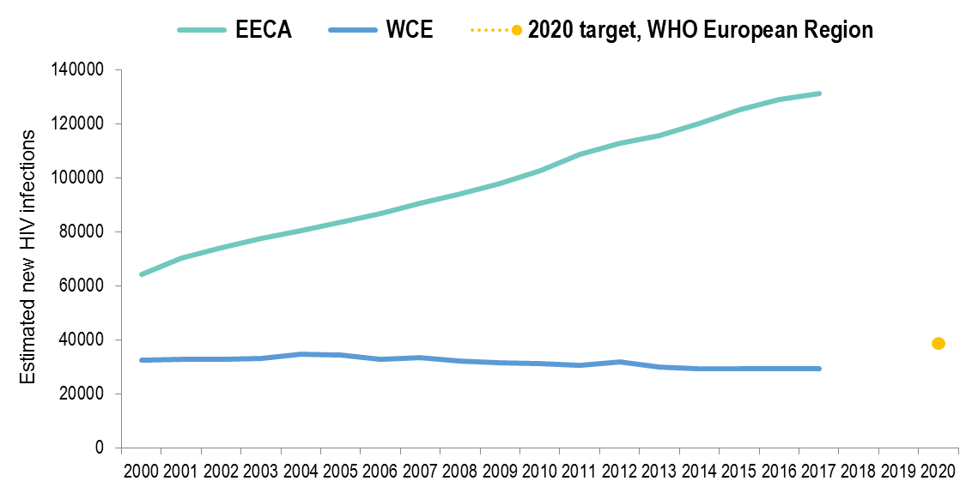
Estimated new HIV infections, 2000-2017 and 2020 target Eastern Europe and Central Asia (EECA) and Western and Central Europe (WCE)
Source: UNAIDS.2018 estimates

Slide 3
Proportion HIV diagnoses in migrants* by country of report, EU/EEA 2016
New diagnoses in migrants from high-endemic countries
New diagnoses in migrants from other countries
EU/EEA: 40% diagnosed in 2016 were born abroad
* Migrants are all persons born outside of the country in which the diagnosis was made.
Data include only cases with known region of origin;
One or no cases were reported among migrants in Hungary or Liechtenstein
Source: ECDC/WHO (2017). HIV/AIDS Surveillance in Europe 2017– 2016 data
Notes:
During the past decade, the number of diagnoses of HIV infection in migrants in Europe has declined sharply, and evidence shows that a significant proportion acquire HIV after arrival in Europe.
40% of HIV cases diagnosed in EU/EEA in 2016 were born abroad.
Unfortunately, we have very little or no data on eastern European and central Asian countries in the official countries report and we rely on those few empirical evidences that exist.

Slide 4
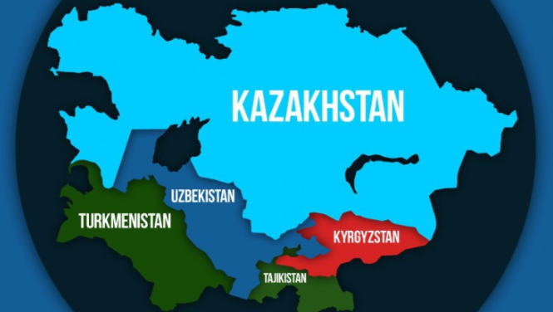
Background
EECA – home to one of the world’s largest international labor migration trends and an important migration corridor
Key migration flows
between central Asian countries and the Russian Federation,
between Ukraine, Caucasus and Moldova and the Russian Federation
within central Asian countries.
Trends not expected to decline.

Slide 5
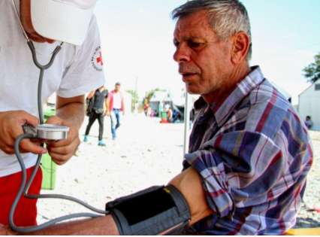
Migrant’s aspects
socioeconomic profile
living and social conditions
risk factors
inadequate access to health care services including HIV prevention and treatment
lack of awareness and/or insufficient legal protection
possible exploitation before, during or after migration
stigma and discrimination

Slide 6
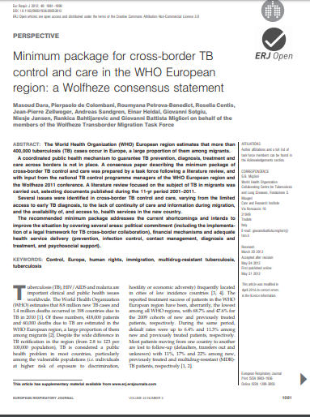
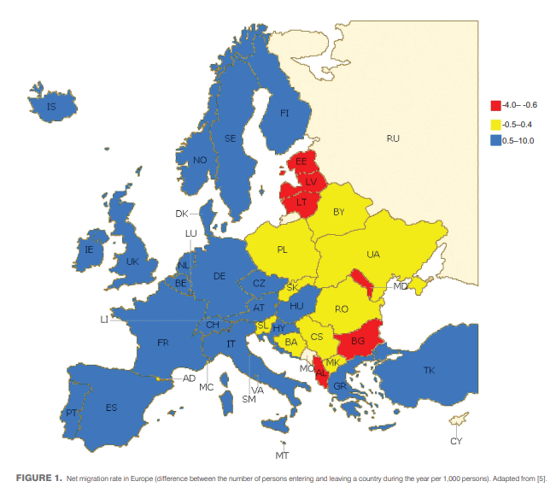
Building on …
Source: http://erj.ersjournals.com/content/erj/40/5/1081.full.pdf

Slide 7
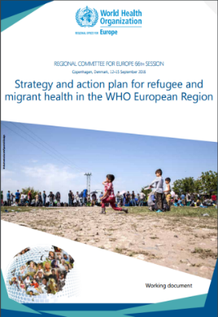
Essential package of HIV services for migrants: Central Asia
Scope and Purpose:
to guide implementation of a package of interventions to ensure HIV diagnosis, treatment and care for migrants in countries of central Asia.
aims to reduce inequalities at national and regional levels in access to HIV services among migrants
September 2017, Copenhagen

Slide 8
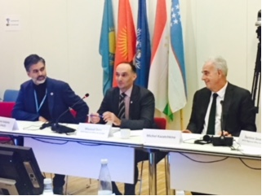
Essential package of HIV services in Migrants: central Asia
Content:
Commitment and stewardship
Legal aspects and ethics
Finance
Service delivery
Surveillance and monitoring
Meeting on 4 central Asia countries an essential package of HIV services in migrants, September 2017, Copenhagen
Notes:
The WHO Essential package of HIV services in migrants: central Asia has 5 main components.
You see on pictures countries of central Asia actively engaging in discussions in September 2017 in a meeting convened and hosted by WHO. Other UN agencies, like UNAIDS, UNODC as well as IOM attended and presented in this meeting.
Countries advised and requested WHO to rigorously revise the 2nd version of the essential package document given that more entities in countries may be involved in such issues related to migration apart from MOH. Countries sent their feedback in March 2018 to WHO. Kaz sent this morning and now we can consider the endorsement from countries reached.

Slide 9
Commitment and stewardship (1)
Political commitment to strengthen HIV prevention, treatment and care for all including documented and undocumented migrants
Intersectoral collaboration
Peer support mechanism
Inter-governmental cooperation through multisectoral agreements
Migrant-sensitive HIV prevention interventions to be embedded in National HIV strategies.

Slide 10
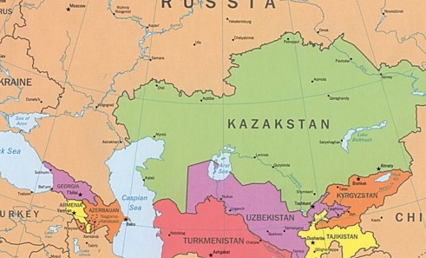
Commitment and stewardship (2)
Harmonize HIV treatment policies, case definitions, reporting and notification mechanisms across countries
Form a regional network on cross- and transborder collaboration, coordination, referral, follow-up and provision of ongoing care and treatment for TB, HIV and TBHIV among migrants, including advocacy

Slide 11
Legal aspects and ethics
Eliminate HIV related stigma, discrimination and violence; review policies related to restrictions on entry, stay and residence based on HIV status with a view to discontinue mandatory testing, detentions and deportations based on HIV status.
To promote well-managed policies and practices that enable achievement of sustainable development goals
Health care to be provided irrespective of migrants’ legal status without discrimination
Provide access to legal services for potential violations of human rights

Slide 12
Finance
Funding to cover costs related to the continuum of HIV services, including treatment for all migrants regardless of their migratory status
International partners commit to work with governments on additional sources of support and innovative financing mechanisms.

Slide 13
Service delivery (1)
Adapt existing health services & provide migrant-sensitive services.
Train HIV specialists to increase cultural sensitivity, address cultural and language barriers and reduce stigma towards migrants.
Host countries and countries of origin of migrants to provide equitable access to prevention services for migrants. Prevention programs should include:
culturally and linguistically adapted information to increase migrants’ awareness on HIV;
HIV testing and counseling among migrant communities;
comprehensive prevention services
Implement interventions adapted to the frequent movements to ensure continuum of HIV services.
To involve outreach services and mobile facilities with involvement of migrant communities, civil society and NGOs.

Slide 14
Service delivery (2)
To ensure access to treatment services for all migrants, including HIV antiretroviral treatment and laboratory monitoring services, consistent with the member-states commitments at UNGA (HLM declaration) and WHO Health assembly (WHO 61.17).
Innovative partnerships with civil society, non-governmental organizations and diaspora.
Upon return to home country, provide confidential voluntary HIV testing and counseling to returning migrants, including referrals and coverage for treatment and care as needed, respecting the right to confidentiality and privacy.

Slide 15
Surveillance and monitoring
Countries are to:
include core indicators for monitoring HIV among migrants in their surveillance systems, including data from HIV and TB services, respecting confidentiality and data protection.
Biological and behavioral surveys among migrant population are necessary to understand the dynamics of HIV among this group and evaluate their needs.
Integrate into national surveillance programmes population-specific behavioural and size estimates surveys to ensure timely evidence on specific populations size and HIV prevalence, among migrants and other key populations, and thus assure further adaptation of evidence based decisions for development of appropriate policies and interventions.
Relevant UN agencies to provide technical support upon countries requests.

Slide 16
Next steps
Disseminate the officially endorsed version of the essential HIV care package for migrants for Central Asia Republics
Cooperating in collecting and analyzing data / strengthen monitoring of HIV, TB, viral hepatitis among migrants
Engaging diaspora, enabling migrants and peer support groups
Raise funds for HIV prevention, treatment and care to cover services for labor migrants across the HIV care continuum
Expand the model to other countries of the Region/global

Slide 17
Acknowledgements:
Member States – central Asia countries
RO and COs colleagues – Masoud Dara, Annemarie Stengaard, Antons Mozalevskis, Jamshid Gadoev, Jarno Habiht, Ihor Pokanevich, Abdulakhada Safarov
UNAIDS, IOM, UNODC
Michel Kazatchkine, Isabela Barbosa
AFEW and Project HOPE
http://www.euro.who.int/en/health-topics/communicable-diseases/hivaids
eurohiv@who.int
Subscribe to our Joint TB, HIV and viral Hepatitis (JTH) newsletter:
www.euro.who.int/tb

